Slide 1
Unit-2
Job Analysis & Planning For Human Resource

Slide 2
Introduction
In a country like India, jobs are very important to individuals. They help to determine standards of living, places of residence, status and even one’s sense of self-worth.
They are important to organizations also because they are the means of accomplishing organizational objectives. Traditionally, organizations used to define jobs in a rigid way.

Slide 3
Job Analysis – Meaning:
Job analysis is a systematic and detailed examination of jobs. It is the process of collecting information about a job — that is, the knowledge, skills, and the experience needed to carry out a job effectively. The jobholder is supposed to possess job-related knowledge useful to carry out the job easily

Slide 4
Job Analysis – Definitions:
According to Edwin B. Flippo – “Job analysis is the process of studying and collecting information relating to the operations and responsibilities of a specific job. The immediate products of this analysis are job descriptions and job specifications.
Further, David A. De Cenzo and Stephen P. Robbins has defined “job analysis is a systematic exploration of the activities within a job. It is a basic technical procedure, one that is used to define the duties, responsibilities and accountabilities of a job.”

Slide 5
Objectives
The main objectives of job analysis are as follows:
Work simplification: A job may be analysed to simplify the process and methods involved in it. This will mean redesigning the job. Work simplification helps to improve productivity of personnel.
Establishment of standards of performance: In order to hire the personnel on a scientific basis, it is very necessary to determine in advance a standard of performance with which applicant can be compared.

Slide 6
3. Support to other personnel activities: Job analysis provides support to other personnel activities such as recruitment ,selection, training, development, performance appraisal, job evaluation.

Slide 7
Benefits of job analysis
Manpower planning: - Job analysis is the qualitative aspect of manpower requirements because it determines the demands of the job in terms of skills, qualities & other human attributes. It facilitates the division of work into different jobs.
Recruitment, selection & placement: - In order to hire a right person on the job. It is very essential to know the requirements of the job & the qualities of the individual who will perform the job.

Slide 8
Training & development: - Job analysis determines the levels of standard of job performing, it helps administering the training development programmes.
Job evaluation: - Job analysis determines provides a basis for job evaluation, job evaluation aims at ‘determining’ the relative worth of the job which in turn helps determining the compensation of job.
Performance appraisal:- Job analysis data provide a clear cut standard of performance for every job. The performance of employee can be assessed objectively with the standard of job performance.

Slide 9
Job designing: - Industrial engineers may use the job analysis information in designing the job by making the comprehensive study of the job elements.
Safety & health: - The management can take corrective measures to minimize the chance of various risks to ensure safety to workers & to avoid unhealthy conditions.
Promotions, transfers:-The job analysis is mainly based on the effective policies. Effective policies may be formulated in regards to promotions & transfers.

Slide 10
Employment guidance: - Job description, which is basically carried out on the basis of the job analysis, helps the aspirates in ascertaining the job, for which they have the necessary ability & skills.
Labour relations analysis: - Job analysis serves as the basis for resolving disputes relating to standards of performance expected of workers.

Slide 11
Job Analysis – Methods:
These are given below:
Observation method
Interview method
Questionnaire method
Previous studies
Work Diary
Manager trying the job

Slide 12
Job Description and Job Specification
Job Analysis is a primary tool to collect job-related data. The process results in collecting and recording two data sets including job description and job specification. Any job vacancy cannot be filled until and unless HR manager has these two sets of data. It is necessary to define them accurately in order to fit the right person at the right place and at the right time. This helps both employer and employee understand what exactly needs to be delivered and how.
Both job description and job specification are essential parts of job analysis information. Writing them clearly and accurately helps organization and workers cope with many challenges while on-board.

Slide 13
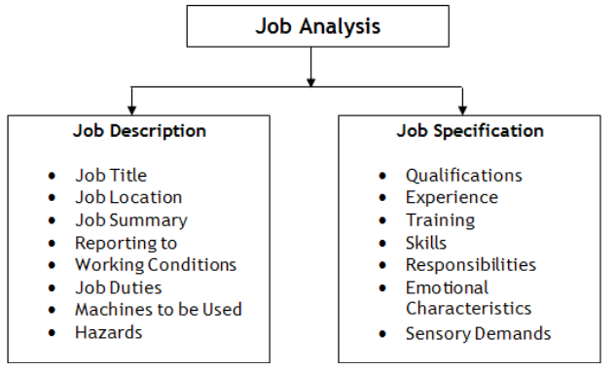

Slide 14
Job Description
Job description includes basic job-related data that is useful to advertise a specific job and attract a pool of talent. It includes information such as job title, job location, reporting to and of employees, job summary, nature and objectives of a job, tasks and duties to be performed, working conditions, machines, tools and equipment’s to be used by a prospective worker and hazards involved in it.

Slide 15
Purpose of Job Description
The main purpose of job description is to collect job-related data in order to advertise for a particular job. It helps in attracting, targeting, recruiting and selecting the right candidate for the right job.
It is done to determine what needs to be delivered in a particular job. It clarifies what employees are supposed to do if selected for that particular job opening.
It gives recruiting staff a clear view what kind of candidate is required by a particular department or division to perform a specific task or job.
It also clarifies who will report to whom.

Slide 16
Job description and job specification are two integral parts of job analysis. They define a job fully and guide both employer and employee on how to go about the whole process of recruitment and selection. Both data sets are extremely relevant for creating a right fit between job and talent, evaluate performance and analyze training needs and measuring the worth of a particular job

Slide 17
Human Resources Planning Meaning
According to Leon C. Megginson human resource planning is “an integrated approach to performing the planning aspects of the personnel function in order to have a sufficient supply of adequately developed and motivated people to perform the duties and tasks required to meet organisational objectives and satisfy the individual needs and goals of organisational members.”
Human resource planning (HRP) is the first step in the HRM process. HRP is the process by which an organization ensures that it has the right number and kind of people, at the right place, at the right time, capable of effectively and efficiently completing those tasks that will help the organization achieve its overall objectives.

Slide 18
HRP is also known by other names such as ‘Manpower Planning’, ‘Employment Planning’, ‘Labour Planning’, ‘Personnel Planning’, etc. HRP is a sub-system in the total organizational planning. In other words, HRP is derived from the organizational planning just like production planning, sales planning, material planning, etc.

Slide 19
Human Resource Planning – Definition:
The organisation’s objectives and strategies for the future determine future requirement of human resources. It only means that the number and mix of human resources are reaction to the overall organisational strategy. If the intent is to get closer to people possessing requisite qualifications, the organisation should act quickly.
Human Resource Planning or Manpower Planning (HRP) is the process of systematically reviewing HR requirements to ensure that the required number of employees with the required skills is available when they are needed. Getting the right number of qualified people into the right job is the crux of the problem here.

Slide 20
Human Resource Planning – Objectives:
Proper assessment of human resources needs in future.
Anticipation of deficient or surplus manpower and taking the corrective action.
To create a highly talented workforce in the organization.
To protect the weaker sections of the society.
To manage the challenges in the organization due to modernization, restructuring and re-engineering.

Slide 21
To facilitate the realization of the organization’s objectives by providing right number and types of personnel.
To reduce the costs associated with personnel by proper planning.
To determine the future skill requirements of the organization.
To plan careers for individual employee.
Providing a better view of HR dimensions to top management
Determining the training and development needs of employees.

Slide 22
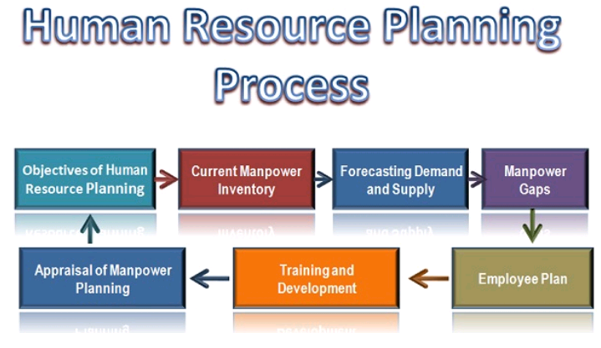
Process of HRP

Slide 23
Determining the Objectives of Human Resource Planning:
The foremost step in every process is the determination of the objectives for which the process is to be carried on. The objective for which the manpower planning is to be done should be defined precisely, so as to ensure that a right number of people for the right kind of job are selected.
The objectives can vary across the several departments in the organization such as the personnel demand may differ in marketing, finance, production, HR department, based on their roles or functions.

Slide 24
Analysing Current Manpower Inventory: The next step is to analyse the current manpower supply in the organization through the stored information about the employees in terms of their experience, proficiency, skills, etc. required to perform a particular job.
Also, the future vacancies can be estimated, so as to plan for the manpower from both the internal (within the current employees) and the external (hiring candidates from outside) sources. Thus, it is to be ensured that reservoir of talent is maintained to meet any vacancy arising in the near future.

Slide 25
Forecasting Demand and Supply of Human Resources: Once the inventory of talented manpower is maintained; the next step is to match the demand for the manpower arising in the future with the supply or available resources with the organization.
Here, the required skills of personnel for a particular job are matched with the job description and specification.
Analysing the Manpower Gaps: After forecasting the demand and supply, the manpower gaps can be easily evaluated. In case the demand is more than the supply of human resources, that means there is a deficit, and thus, new candidates are to be hired.
Whereas, if the Demand is less than supply, there arises a surplus in the human resources, and hence, the employees have to be removed either in the form of termination, retirement, layoff, transfer, etc.

Slide 26
Employment Plan/Action Plan: Once the manpower gaps are evaluated, the action plan is to be formulated accordingly. In a case of a deficit, the firm may go either for recruitment, training, interdepartmental transfer plans whereas in the case of a surplus, the voluntary retirement schemes, redeployment, transfer, layoff, could be followed.
Training and Development: The training is not only for the new joinees but also for the existing employees who are required to update their skills from time to time.
After the employment plan, the training programmes are conducted to equip the new employees as well as the old ones with the requisite skills to be performed on a particular job.

Slide 27
Appraisal of Manpower Planning: Finally, the effectiveness of the manpower planning process is to be evaluated. Here the human resource plan is compared with its actual implementation to ensure the availability of a number of employees for several jobs.
At this stage, the firm has to decide the success of the plan and control the deficiencies, if any.Thus, human resource planning is a continuous process that begins with the objectives of Human Resource planning and ends with the appraisal or feedback and control of the planning process.

Slide 28
Advantages of HRP
1. Improvement of labour productivity
2. Recruitment of qualified HR
3. Rapid technological changes
4. Reducing labour turnover
5. Control over Recruitment & training cost
6. Mobility of labour
7. It can facilitate expansive programmes
8. To treat the manpower like real corporate assets

Slide 29
Limitations/Barriers of HRP
1. The future is uncertain :- The future in any country is uncertain i.e. there are political, cultural, technological changes taking place every day. This effects the employment situation. Accordingly the company may have to appoint or remove people. Therefore HRP can only be a guiding factor. We cannot rely too much on it and do every action according to it.
2. Conservative attitude of top management :- Much top management adopts a conservative attitude and is not ready to make changes. The process of HRP involves either appointing. Therefore it becomes very difficult to implement HRP in organization because top management does not support the decisions of other department.

Slide 30
3. Problem of surplus staff :- HRP gives a clear out solution for excess staff i.e. Termination, layoff, VRS,. However when certain employees are removed from company it mostly affects the psyche of the existing employee, and they start feeling insecure, stressed out and do not believe in the company. This is a limitation of HRP i.e. it does not provide alternative solution like re-training so that employee need not be removed from the company
4. Time consuming activity :- HRP collects information from all departments, regarding demand and supply of personnel. This information is collected in detail and each and every job is considered. Therefore the activity takes up a lot of time.

Slide 31
5. Expensive process :- The solution provided by process of HRP incurs expense. E.g. VRS, overtime, etc. company has to spend a lot of money in carrying out the activity. Hence we can say the process is expensive.

